Slide 1
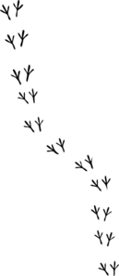
Poultry Jeopardy
UGA Department of Poultry Science Presents…

Slide 2
History of the Chicken | Process that Chicken | Disease Disasters | Name That Chicken | Foghorn Leghorn | House Full of Chicks
200 | 200 | 200 | 200 | 200 | 200
400 | 400 | 400 | 400 | 400 | 400
600 | 600 | 600 | 600 | 600 | 600
800 | 800 | 800 | 800 | 800 | 800
1000 | 1000 | 1000 | 1000 | 1000 | 1000

Slide 3
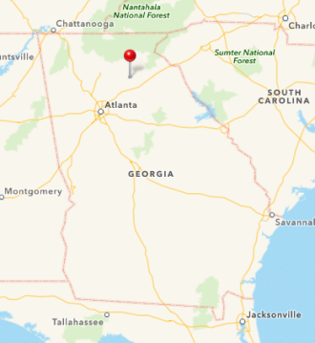
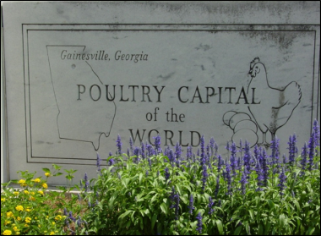
History of the Chicken - 200
The Poultry Capital of the WORLD is located in this city and state.
Gainesville, Georgia
Where is Gainesville, Georgia?

Slide 4

History of the Chicken - 400
This activity was the reason why chickens were originally domesticated for human use.
What is Chicken Fighting?

Slide 5
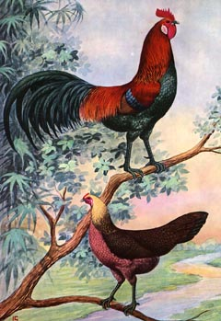
History of the Chicken - 600
This breed of chicken is the ancient precursor to the modern chicken, originating in South Asia.
What is the Red Junglefowl?

Slide 6
History of the Chicken - 800
In 1923, Mrs. Wilmer Steele of Sussex County, Delaware accidentally got 500 baby chicks instead of the 50 she had ordered. She raised and sold the chicks, thus pioneering this division of the industry.
What is the commercial broiler industry?
  Broilers are the chickens raised and sold for meat. The layer industry is responsible for table eggs.

Slide 7
History of the Chicken - 1000
This type of business integration means that one company owns or contracts all aspects of the process and is the model that is used in the poultry industry.
What is vertical integration?
  The poultry industry is vertically integrated, this means that one parent company owns everything from growing the chickens to the processing of them at market age. Think: they own it from the ground up.

Slide 8
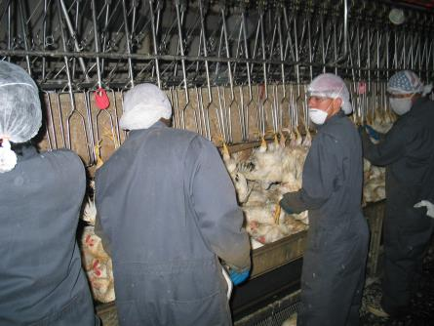
Process that Chicken - 200
This is the name of the process by which chickens are ____ upside down by hand. It is also the first step in processing a chicken.
What is hanging?
  The chickens are individually picked up and hung on the shackles upside down.
  Dirty
  Labor-intensive

Slide 9
Process that Chicken - 400
The purpose of this process is to make the bird still and prepare it for humane killing.
What is stunning?
Stunning utilizes electricity to make the bird still. The shackles that the legs are in are grounded and the combs touch salty, electrified water, thus ‘stunning’ the bird.
There are two types: electric and gas

Slide 10
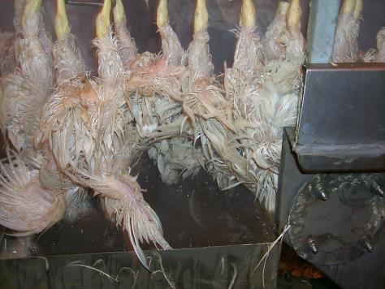
Process that Chicken - 600
Removal of the feathers is helped by this process. It can involve either extremely hot water or steam. Both forms introduce high heat to the feather follicles and ease the picking process.
What is scalding?

Slide 11
Process that Chicken - 800
This person checks and evaluates the chicken carcasses before they proceed to the final step of processing.
Who is the USDA Inspector?
  They inspect the meat for defects such as bruises, discolorations, and feathers. Bone-in products have no broken bones. For whole birds and parts with the skin on, there are no tears in the skin or exposed flesh that could dry out during cooking, and a good covering of fat under the skin. Also, whole birds and parts will be fully fleshed and meaty.

Slide 12
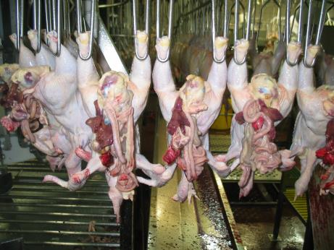
Process that Chicken - 1000
In the grocery store, we do not see whole chicken with internal organs inside of them. This is the name of the process that gets rid of these organs (or viscera).
What is evisceration?

Slide 13
Disease Disasters - 200
This microorganism infects humans and causes severe gastric distress. It is a normal body flora in chicken and only causes havoc in humans when the poultry product is not properly prepared.
What is Salmonella Serotype Enteritis?
  Eggs are the most common source of infection with this bacterium. Raw or runny eggs are the cause and being uncooked does not properly eliminate the bacterium.

Slide 14
Disease Disasters - 400
This flu-like virus is named for the species of animal which it infects. It has a mildly pathogenic form and a highly pathogenic form. An outbreak of this disease would completely ruin Georgia’s agricultural economy for months!
What is Avian Influenza?
  Currently, there is not an effective treatment for flocks infected with AI. This disease is highly monitored and severely infected flocks are destroyed. Vaccination for this disease is widespread and useful in prevention

Slide 15
Disease Disasters - 600
This disease causes tumors in the chickens and is a type of avian cancer. It infects chickens 12-25 weeks of age and can cause the chicken to be deemed not good for human consumption during processing.
What is Marek’s Disease?
  This virus is transmitted via the air in the poultry house and there is no treatment for it. Prevention with vaccination is the best bet and does not even prevent infection, it only prevents tumor formation.

Slide 16
Disease Disasters - 800
This disease infects the respiratory tract of birds of any age. It is not uncommon to hear labored breathing, see facial swelling, paralysis, and twisting of the neck. Mortality is 10-80% depending on the pathogenicity.
What is Newcastle Disease?
  Newcastle can be spread over short distances via the air or by improper biosecurity techniques practiced by farm workers.
  There is no specific treatment, but prevention includes vaccination and biosecurity programs.

Slide 17
Disease Disasters - 1000
This policy’s objective is to provide a cooperative Industry-State-Federal program through which new diagnostic technology can be effectively applied to the improvement of poultry.
What is the National Poultry Improvement Plan?
  Originally was started in the 1930’s to eliminate the spread of Pullorum disease, but has now been extended to Pullorum-Typhoid free, even though several other diseases have been specified.
  The only agency in Georgia able to certify a flock as clear under NPIP is the Georgia Poultry Lab Network (GPLN).

Slide 18
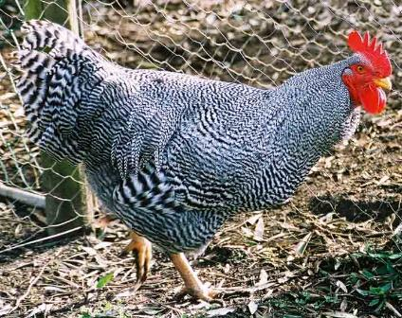
Name that chicken - 200
What is a Barred Plymouth Rock?

Slide 19
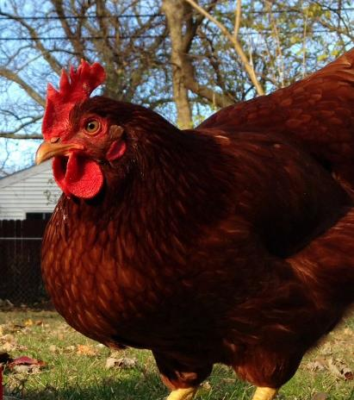
Name that chicken - 400
What is a Rhode Island Red?

Slide 20
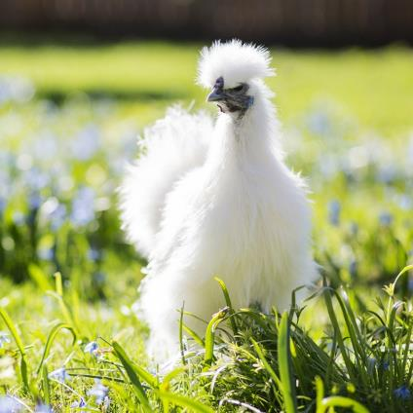
Name that chicken - 600
What is a Silkie Bantam?

Slide 21
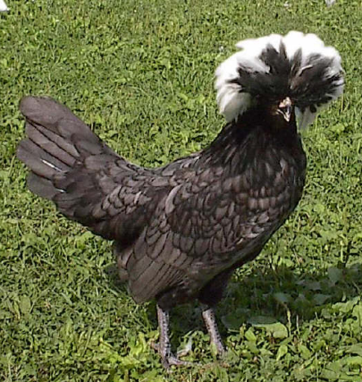
Name that chicken - 800
What is a White Crested Black Polish?

Slide 22
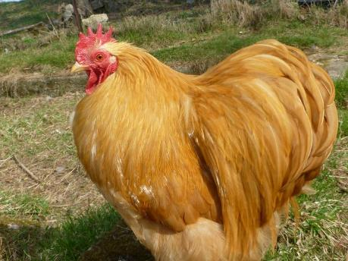
Name that chicken - 1000
What is a Buff Cochin?

Slide 23
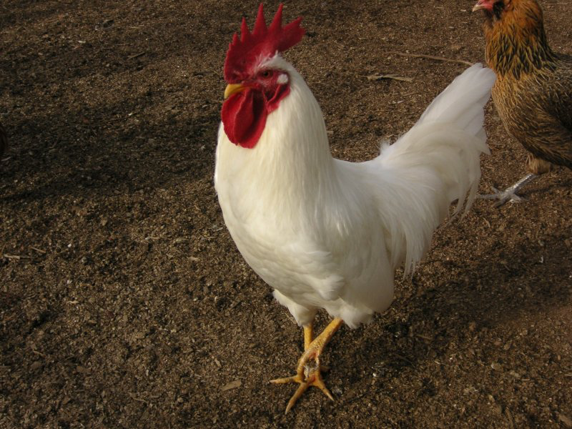
Foghorn Leghorn - 200
This breed of chicken lays the white eggs that we eat (table eggs).
What is a White Leghorn?

Slide 24
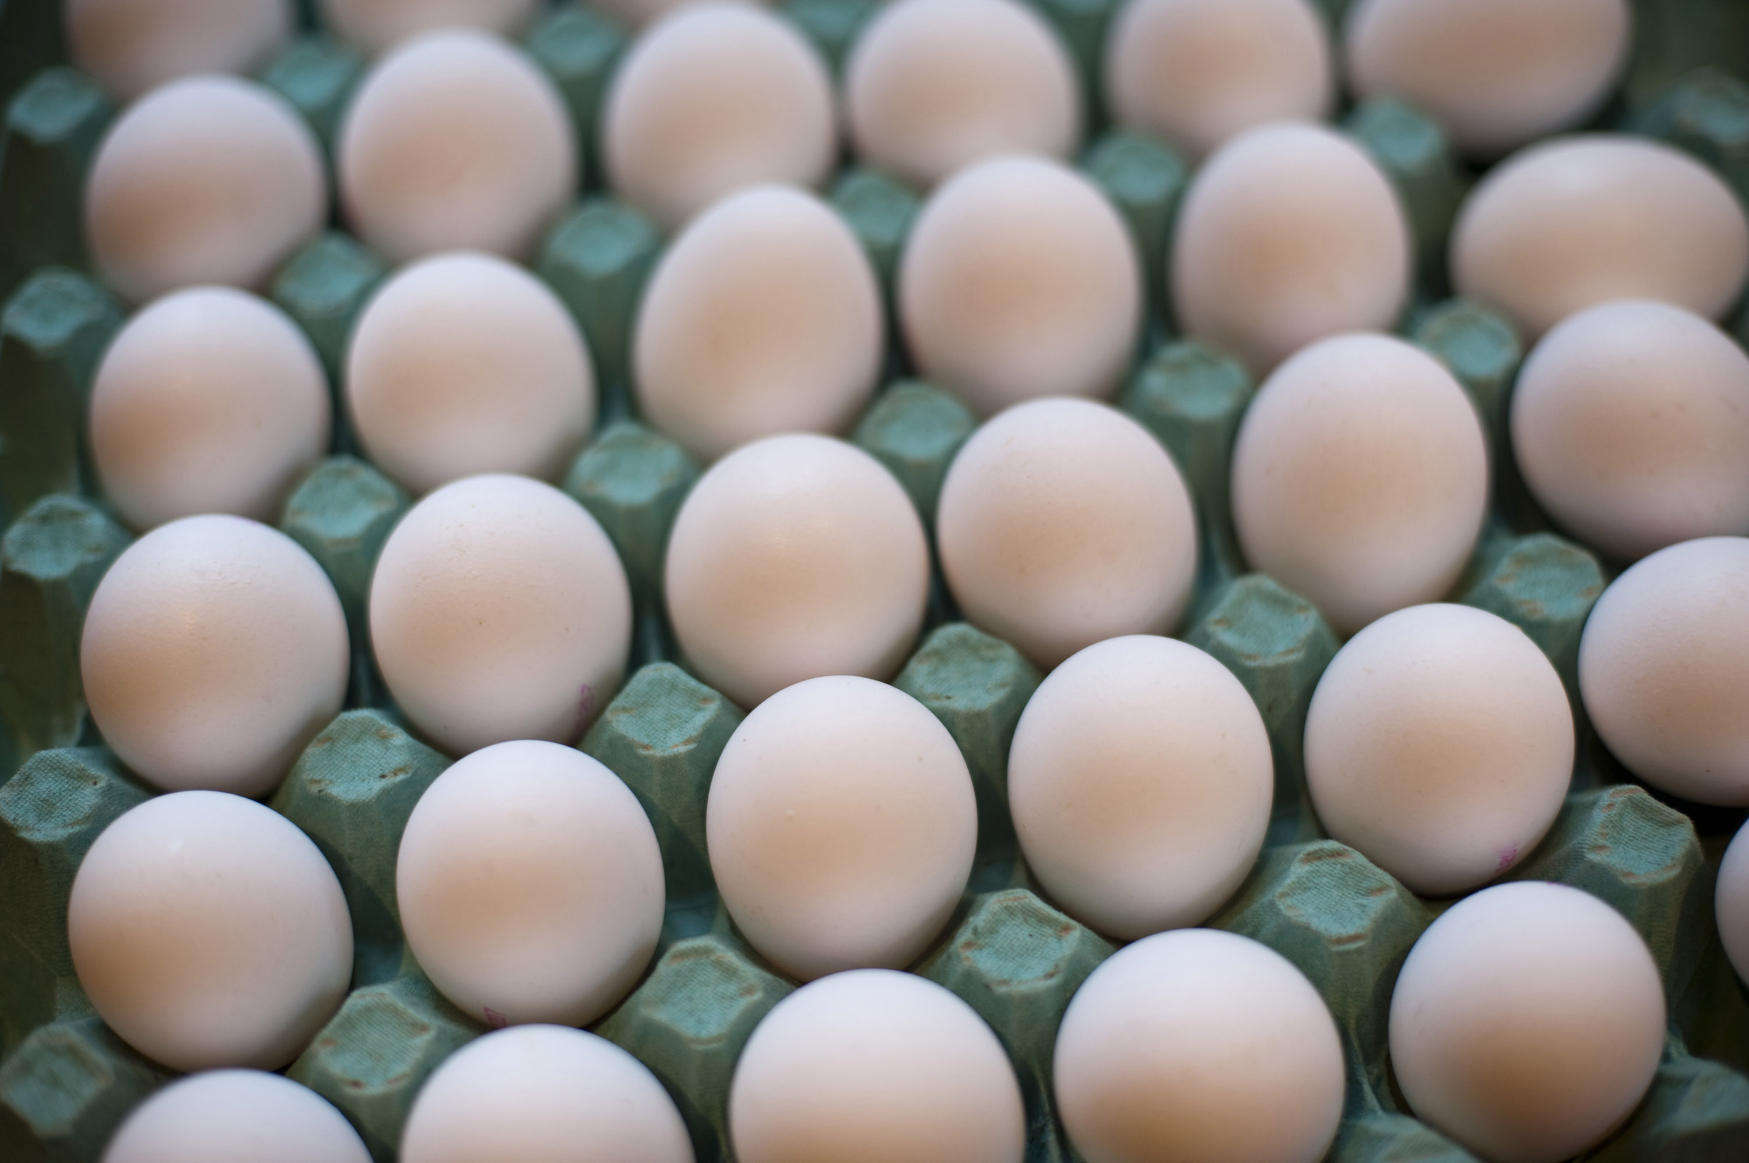
Foghorn Leghorn - 400
The average laying hen can lay an egg every 26 hours, meaning they can lay this many eggs in a year.
How many is 265 eggs per year?

Slide 25
Foghorn Leghorn - 600
This is the number of days it takes to hatch an egg.
What is 21 days?

Slide 26
Foghorn Leghorn - 800
This is the age that laying hens reach sexual maturity and can begin to lay eggs.
What is 6 months?

Slide 27
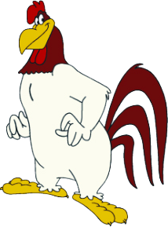
Foghorn Leghorn - 1000
This cartoon character appeared on Cartoon Network’s Loony Tunes show. He has a strong “good ol’ boy” southern accent and is fond of saying “That's a joke, ah say, that's a joke, son.”
Who is Foghorn Leghorn?

Slide 28
House Full of Chicks - 200
This is the name of the giant warehouse-like structures that house broiler chickens while they grow—from the time they arrive at the building from the hatchery until they are market age and weight.
What is a growout house?
  Growout houses are long chicken houses, most commonly 400’ long and 40’ wide and house up to 20,000 birds.
  Chickens in growout houses are from broiler breeders that produce fertilized eggs.

Slide 29
House Full of Chicks - 400
Being able to grow chickens year-round is not an easy task. Name 2 stressors that should be taken into consideration when raising chicken.
Temperature
Access to feed and water
Disease
Air quality

Slide 30
House Full of Chicks - 600
This is the substance that is illegal to administer to chickens in the growout house. It is also considered uneconomical and labor strenuous.
What are growth hormones?

Slide 31
House Full of Chicks - 800
The temperature in the growout house remains the same throughout the year to ensure comfort and maximum meat yield for chickens. This is the system that regulates it.
What is automated temperature control?

Slide 32
House Full of Chicks - 1000
This is the age broilers are considered ready for pick up and sent to the processing plant.
What is 5 weeks of age?

